Slide 1
Appendicular Skeleton

Slide 2
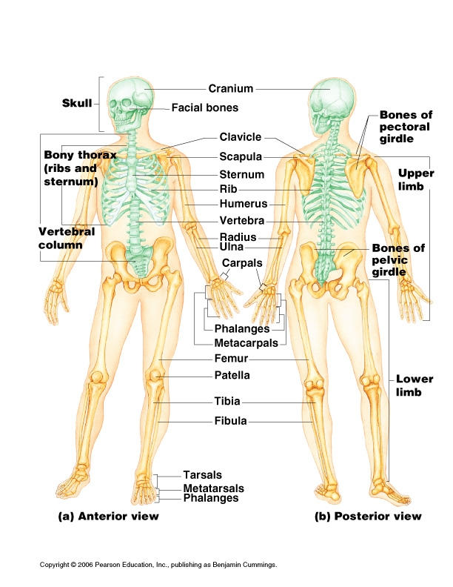

Slide 3
Appendicular Skeleton- Consists of:
Pectoral girdle & arms
Pelvic girdle & legs

Slide 4
Upper Pectoral
Clavicle - “collarbone”
Functions: attachment point for muscles, brace to hold the arm laterally, transmits compression to axial skeleton

Slide 5
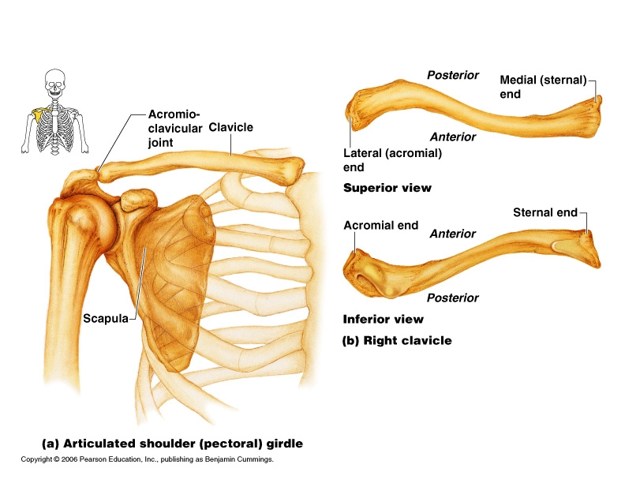

Slide 6
Clavicle
Curve- guarantees the break is not against any blood vessels

Slide 7
Clavicle
Medially articulates with manubrium (top part of sternum)
Laterally articulates with the scapula at the acromial process

Slide 8
Scapulae
“Shoulder blade”
Lies on the dorsal surface of the rib cage

Slide 9
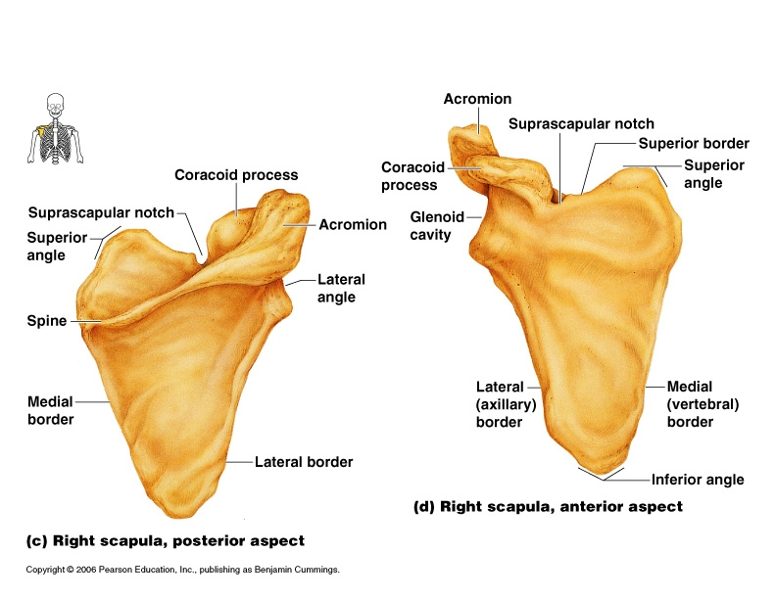

Slide 10
Scapulae markings
Posterior
Spine
Acromion process- end of the spine that connects to the clavicle
  “point of shoulder”
Anterior
Coracoid process-”bent little finger” anchors biceps
Suprascapular notch- nerve passage

Slide 11
Scapulae markings
Lateral
Glenoid cavity- a shallow socket that receives the head of the humerus
  Advantage= the shoulder is flexible because it is a loose attachment
  Disadvantage= makes it unstable and easy to dislocate

Slide 12
Humerus
Proximal:
Head
  Greater tubercle and Lesser tubercle-muscle attachment
Shaft:
Anterior- Deltoid Tuberosity - muscle
Posterior- Radial Groove – radial nerve

Slide 13
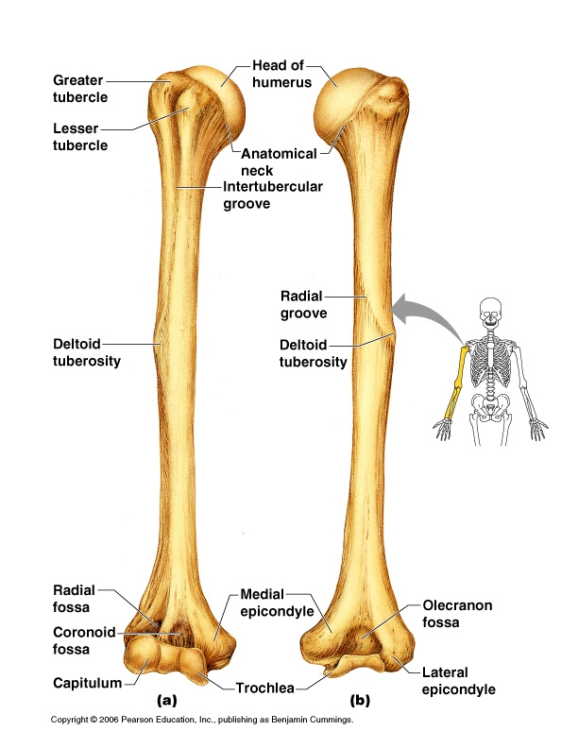

Slide 14
Distal Humerus
-Trochlea- looks like a spool
-Capitulum- lateral, “ball like”
-Coronoid Fossa- anterior depression above
the trochlea
-Olecranon Fossa- posterior depression above the trochlea
-Medial and lateral epicondyles=muscle attachments

Slide 15
Lower arm- 2 bones
Radius- Lateral (thumb side)
  head- proximal meets capitulum
  styloid process- distal lateral bump

Slide 16
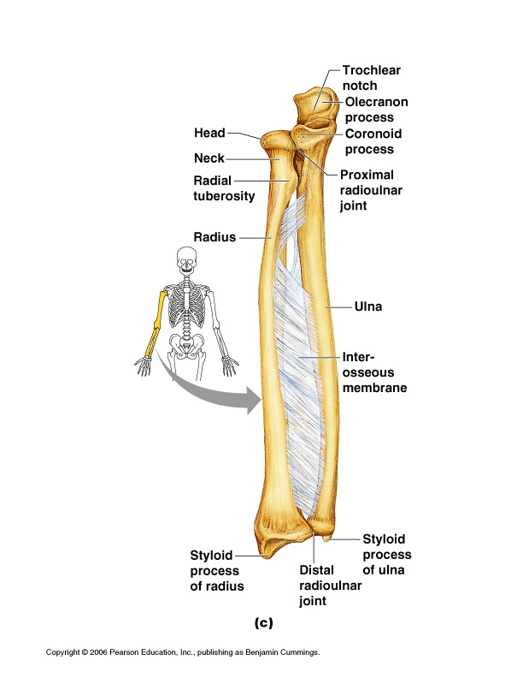

Slide 17
Lower arm
Ulna- medial (pinky side) “wrench”
  olecranon process
  trochlear notch
  coronoid process
  Hooks onto the trochlea of the humerus

Slide 18
Hand
Carpus- wrist (8 bones)
Lateral to medial- two rows of 4
Scaphoid Trapezium
Lunate Trapezoid
Triquetral Capitate
Pisiform Hamate
“Sally left the party to take Cathy home”

Slide 19
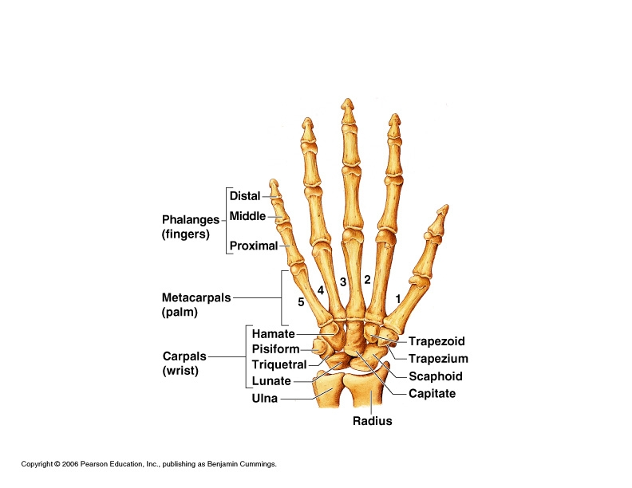

Slide 20
Hand
Metacarpals- 1 -5
  Palm to knuckles
  lateral to medial

Slide 21
Hand
Phalanges- (14) fingers and thumb
Fingers- 3 bones
-proximal, middle, distal
Thumb- (pollex) 2
-proximal, distal

Slide 22
Pelvic Girdle
Functions: attaches lower limbs, transmits weight, supports visceral organs
Secured by the strongest ligaments in the body
Stable

Slide 23
Hip
Hip = “ os coxae”
-2 coxal bones made of three fused bones

Slide 24
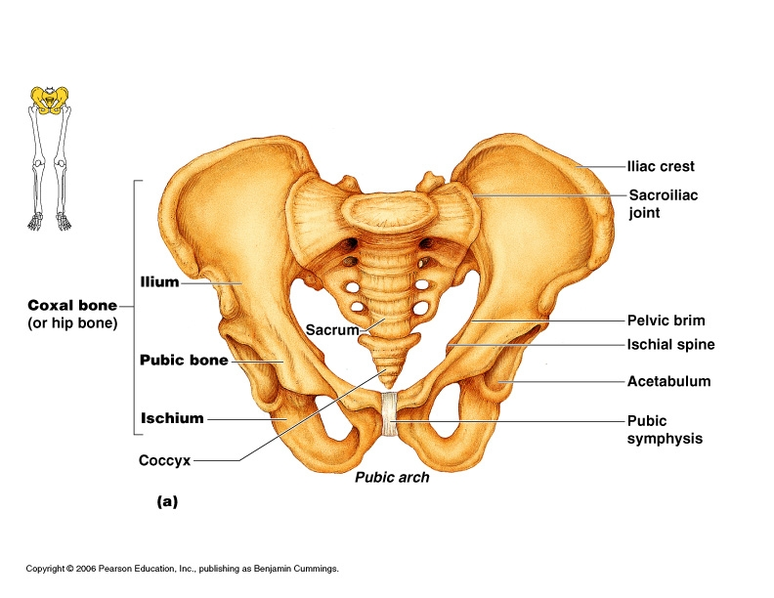

Slide 25
Hip
Fused bones:
Ilium
Point
Ischium of = Acetabulum
Fusion
Pubis

Slide 26
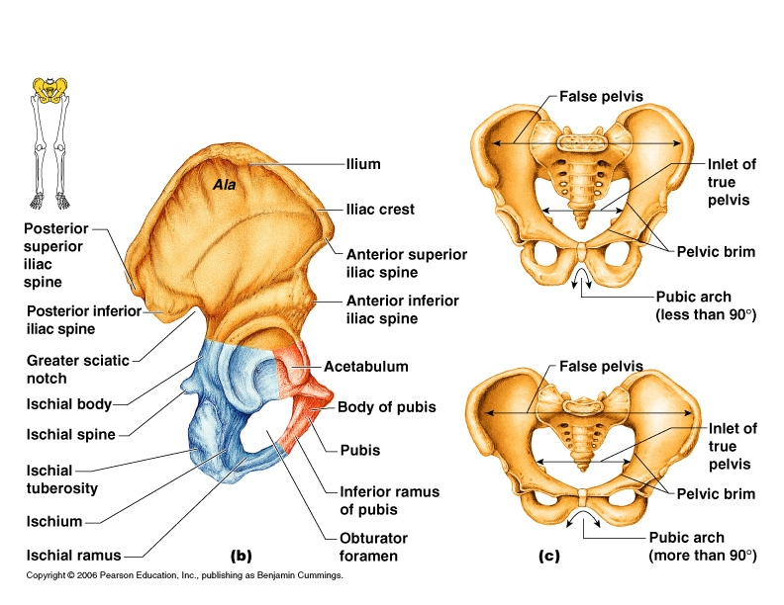

Slide 27
Hip
Acetabulum = “Hip Socket”

Slide 28
Ilium- large flaring bone
Iliac Crest -wings
-Anterior Superior Iliac Spine- end of the
anterior superior iliac crest
-Posterior Superior Iliac Spine- end of the posterior superior iliac crest

Slide 29
Ilium
Greater sciatic Notch- posterior deep indentation where the thick cord like sciatic nerve enters the thigh
Auricular Surface- medial rough area that articulates with the sacrum

Slide 31
Ischium –posterior inferior
Lesser sciatic notch- nerves & blood vessels pass to anal and genital area
Ischial spine- attaches ligament
Ischial tuberosity- buttocks, strong when you sit, it holds your weight

Slide 32
Pubis – anterior
Obturator foramen- for blood vessels, covered in membrane
Pubic symphysis- joint
Pubic arch/angle- distinguish males and females

Slide 33
Female Pelvis
True pelvis- important for childbirth
Ischial spine is shorter
Pelvis is shallower, lighter
Pubic angle is greater
Pubic arch is more round
Iliums flare more laterally
Inlet is larger and rounded

Slide 35
Abnormality
Dysplasia- the acetabulum is shallow and the head of the femur will slip out

Slide 36
Femur- Thigh
Largest, longest, strongest bone
Head
Fovea Capitas- attachment of a small ligament that secures the bone into the socket – looks like a small pit on the top center of the head
Neck –weakest area prone to fracture (broken hip)

Slide 37
Femur- proximal
Greater Trochanter- lateral
Lesser Trochanter – medial
  Both are the site of thigh and buttocks muscles
Gluteal tuberosity-muscle attachment

Slide 38
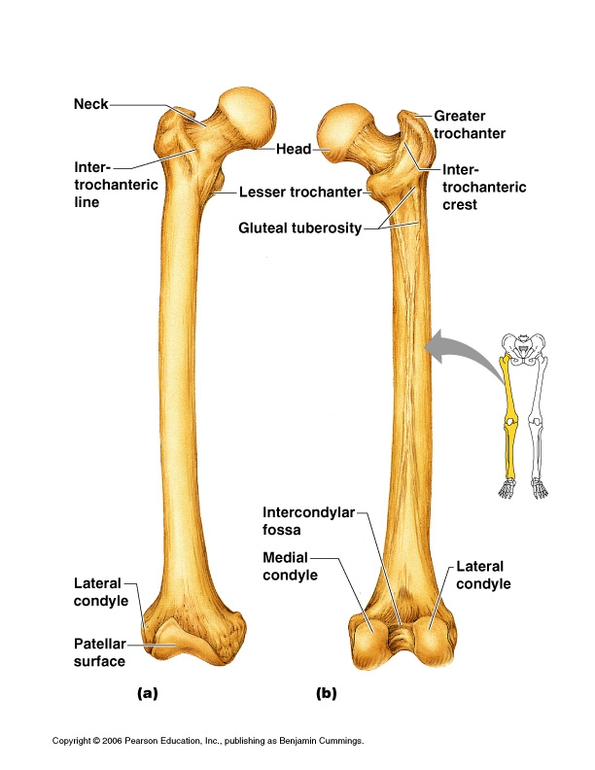

Slide 39
Distal Femur- posterior
Lateral and medial condyles-articulates with the tibia
Intercondylar Notch- “U” shaped between condyles
Lateral Epicondyles- superior to condyles
Medial Epicondyles

Slide 40
Tibia
Proximal:
Medial and lateral condyles- articulates with the femur
Intercondylar Eminence = point between
condyles
Tibial tuberosity- anterior attaches patellar ligament

Slide 41
Shaft: is wider posterior than anterior (shin)
Distal: articulates with talus of foot
Medial malleolus- inner medial ankle

Slide 42
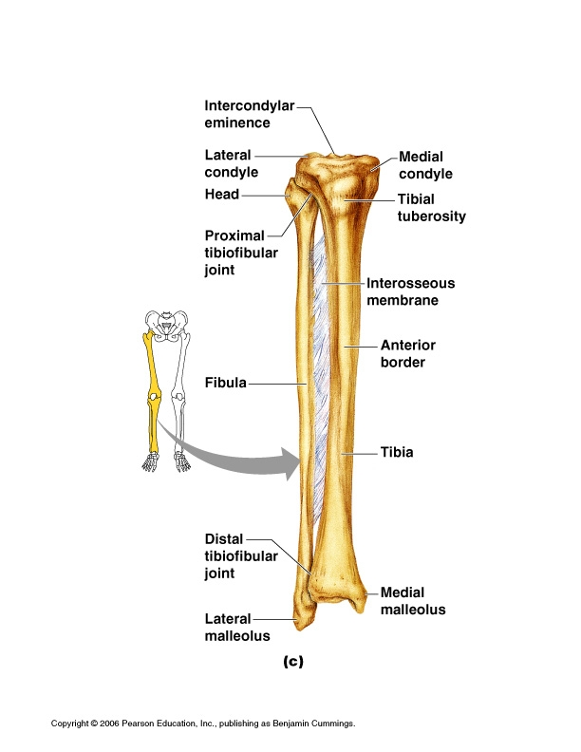

Slide 43
Fibula
Only stabilizes the ankle
Thinner bone in the shin on the lateral side
proximal = Head
distal = Lateral Malleolus – lateral
ankle

Slide 44
Foot
Tarsus, Metatarsus, Phalanges
Function: Support, lever to propel weight forward

Slide 45
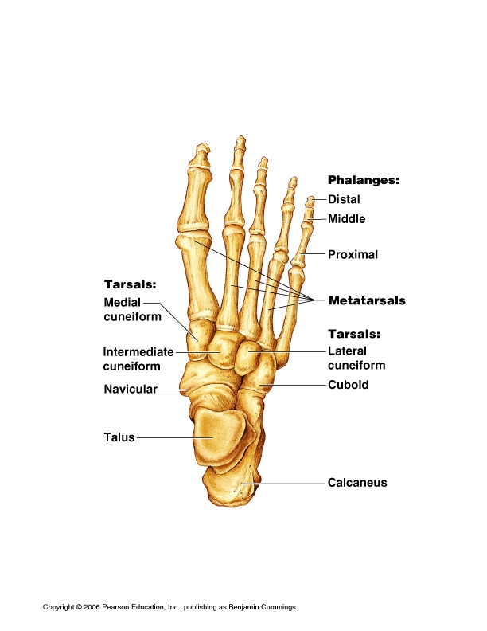

Slide 46
Tarsus= 7 tarsal bones
1. Talus- articulates with tibia and fibula
2. Calcaneus- heel bone
-Calcaneal = Achilles Tendon
-Calcaneal Tuberosity- part that touches ground
3. Cuboid- lateral
4. Navicular- medial
5, 6, 7.
Cuniform-medial, intermediate, lateral

Slide 47
Metatarsus- 5 (I to V)
Starting medial with big toe (I)
Enlarged distal head forms the “ball of the foot”

Slide 48
Phalanges (Toes) 14
Big toe – 2 parts proximal and distal
Toe 2,3,4,5 – 3 parts: proximal, middle, distal

Slide 49
Arches
Maintained by ligaments and tendons
3 arches:
  Medial longitudinal
  Lateral longitudinal
  Transverse

Slide 50
