Slide 1
Bellwork
Compare and contrast lipids and carbohydrates.

Slide 2
Chemical Reactions

Slide 3
What is a chemical reaction?
A chemical reaction changes substances (such as oxygen and sugar) into different substances by breaking and making chemical bonds.
Ex: Photosynthesis

Slide 4
Reactants vs. Products
Reactants are the substances changed during a chemical reaction.
Products are the substances made by a chemical reaction.

Slide 5
Exothermic Reactions
Exothermic reactions release more energy than it absorbs (takes in).
Example: Fireflies give off light that comes from an exothermic reaction.

Slide 6
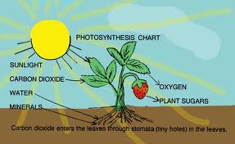
Endothermic Reaction
Endothermic chemical reactions absorbs more energy than it releases.
Example: Photosynthesis

Slide 7
