Slide 1
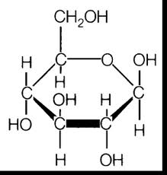
Bellwork
Which of the following macromolecules is this?
A. lipid
B. Carbohydrate
C. Protein
D. Nucleic acid

Slide 2
Enzymes!

Slide 3
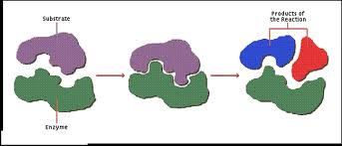
Enzymes
Enzymes are catalysts for chemical reactions in living things. They lower the activation energy and increase the rate of chemical reactions.

Slide 4
Why are enzymes important to living organisms?
Enzymes are involved in almost every process in an organism from breaking down food to building proteins.
Example: The enzyme, amylase, is found in saliva and it breaks down starch into simple sugars.

Slide 5
Activation Energy
Activation energy is the amount of energy that needs to be absorbed (taken in) for a chemical reaction to start.
By lowering the activation energy, everything can happen more quickly.

Slide 6
Activation Energy and Enzymes
Activation energy for a chemical reaction comes from an increase in temperature.
The higher the temperature, the faster the chemical reaction will be (if the temperature is too high, the reaction will slow too much or stop).

Slide 8
What are enzymes made up of?
Almost all enzymes are proteins (long chains of amino acids).
Enzymes depend on its structure to function correctly. Things like temperature and pH (acids and bases) can affect the shape and function of an enzyme.

Slide 9
Enzyme Structure
Enzyme structure is important because each enzyme’s shape allows only certain reactants to bind to the enzyme.
The specific reactants that an enzyme uses are called substrates.
The substrates bind to the active site, which allows the enzyme to speed up the chemical reaction.

Slide 10
Lock and Key Model
This model explains how enzymes work.
First, enzymes bring substrates (reactants) close together.
Second, enzymes decrease activation energy and weakens the bonds.
The reaction forms a product that is released from the enzyme.
Enzyme Animation

